Slide 1
Web presence project
Crafting and compelling website analysis, audit and recommendations
Subiksha S|mbe 11

Slide 2
1.Company selection
I have selected Freshworks for this web compelling project.
About Freshworks :
Freshworks is a well-known SaaS (Software as a Service) company that provides customer engagement and IT service management solutions.
Founded: 2010 by Girish Mathrubootham and Shan Krishnasamy.
Headquarters: San Mateo, California, with a significant presence in Chennai, India.
Business Model: Freshworks operates on a SaaS (Software as a Service) model, offering cloud-based software products.

Slide 3
2.Product and service descriptions
A wide suite of products designed to improve customer and employee experience:
Freshdesk – Customer support software
Freshservice – IT service management
Freshsales – CRM for sales teams
Freshmarketer – Marketing automation
Freshchat – Messaging software for customer engagement
Freshcaller – Call center software

Slide 4
Market positioning of Freshworks
Target Audience: Small and medium-sized businesses (SMBs) and mid-market enterprises looking for affordable, easy-to-use customer support and engagement software.
Global Presence: With customers in over 120 countries, Freshworks is known for serving companies of various sizes. They boast notable clients like Bridgestone, Klarna, Blue Nile, and Delivery Hero.

Slide 5
Growth and recognition
Freshworks became a unicorn (a privately held startup valued at over $1 billion) in 2018.
In September 2021, Freshworks went public on the NASDAQ.
Freshworks has increasingly focused on AI-driven features, offering tools like chatbots and AI-based support automation to help businesses enhance customer interactions.
Competitors:
Zendesk, Salesforce, HubSpot, Zoho, and ServiceNow.

Slide 6
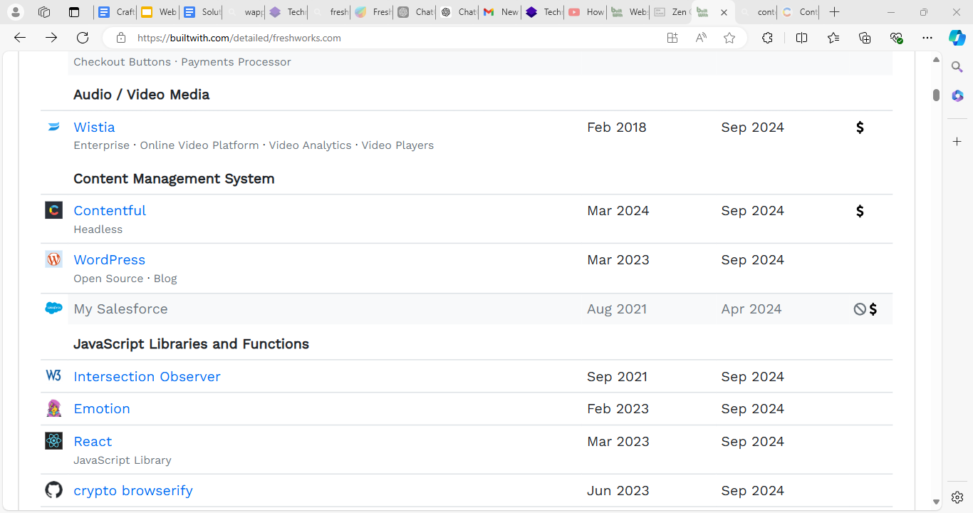
3.Website platform identification
The website is developed on Wordpress and contenful CMS
It is identified using Builtwith and wappalyzer.

Slide 7
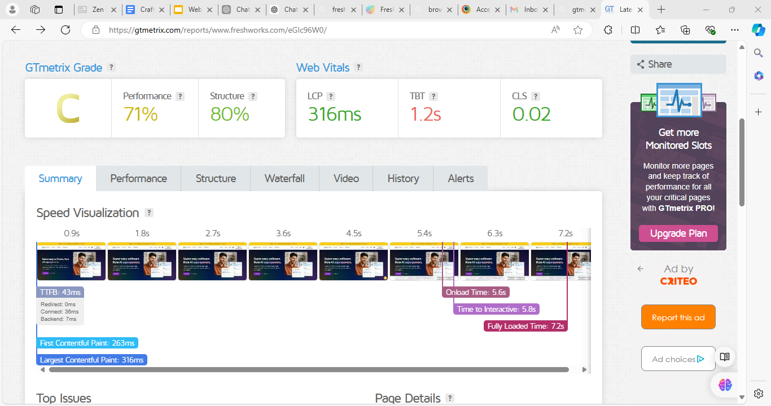
Performance report
Performance metrics of the website:
Tools used – Gtmetrix, Browserstack, Google mobile friendly test.

Slide 8
4.Responsive design testing
Freshworks Homepage:
The responsive time of the webpage is good with recommended score. Interactive time is much longer than recommended.
Service page:
Overall good responsive page but image optimization is needed in this page.
Support page:
Good responsive score but Java scripts need to be minified also its execution time needs to be reduced.

Slide 9
5.Website mistake identification
The pages contain images with no alt tags.
The pages having excessive DOM size.
Java script execution time should be reduced.
The images should be sized properly.
HTML tag is missing in some pages.
The speed of the homepage should be optimized.
Site has invalid robot.txt file.

Slide 10
Suggestion
A large DOM will increase memory usage, cause longer style calculations, and produce costly layout reflows.
Consider reducing the time spent parsing, compiling, and executing JS. You may find delivering smaller JS payloads helps with this.
To optimize HTML tags, ensure proper use of semantic tags, for accessibility and SEO, and minimize redundant tags or inline styles to reduce page load time. Keep the code clean and well-structured for better readability and performance.
Check for errors using Google Search Console's "robots.txt Tester" and update it as needed for correct indexing to properly crawl the robots.txt file.

Slide 11
6.Website best practices list
Ensuring intuitive, well-organized menus for users to easily access company’s features or pages.
Optimizing images, scripts, and caching mechanisms to ensure fast load times, which is crucial for both user experience and SEO.
Maintaining a clean interface with clear CTAs, easy forms, and logical user flow to guide users through the company’s product offerings.
Implementing HTTPS, secure APIs, and regular updates to keep user data and company’s app integrations safe.

Slide 12
Implementing tracking using Google Analytics or the company’s native analytics to monitor user behavior and make data-driven improvements.
Using proper meta tags, structured data, and accessible content to improve visibility on search engines.
Product-related content, such as FAQs, knowledge bases, or blogs, regularly updated to ensure fresh, relevant information.
These practices will improve the overall site’s visibility and ranks high in Search Engine Optimization.

Slide 13
7.Landing page design
Objective: Lead generation and product promotion.
Design features:
Strong headline with a clear value proposition.
Subheadline offering further details.
Eye-catching hero image or product demo video.
Prominent call-to-action (CTA) button

Slide 14
Key benefits of using Freshworks (e.g., improved response times, better customer engagement).
Logos of well-known clients who use Freshworks.
Customer testimonials and case studies.
Embedded product demo or the option to schedule a one-on-one demo.
Designed the landing page using Hubspot.

Slide 15
Landing page of freshsales
Landing page design :
https://freshworks-47353419.hubspotpagebuilder.com/freshworks
A dedicated landing page helps capture qualified leads by focusing on Freshsales value, attracting potential customers interested in CRM solutions.
With clear calls-to-action and tailored messaging, the landing page drives higher conversions by guiding visitors through the sales funnel effectively.
The landing page highlights Freshsales features and benefits, providing detailed insights that educate prospects and build product interest.

Slide 16
Conclusion
This project aims to leverage digital marketing principles and hands-on practice to provide valuable insights and recommendations for creating compelling websites and landing pages.
I have crafted a landing page that effectively showcases the Freshworks product freshsales, aiming to generate leads and enhance brand awareness.
The actionable insights and design recommendations provided will contribute to the continuous improvement and optimization of Freshwork’s digital presence.

Slide 17
Thank you !!

